Slide 1

Basic C Training
Trainer: Priya

Slide 2
PRE - REQUIREMENT?
System
Interest
INTEREST
TIME

Slide 3
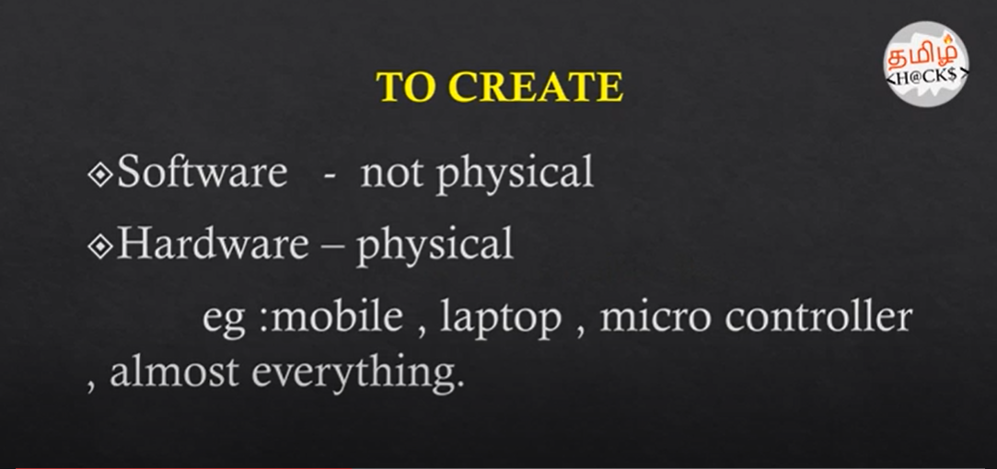
PROGRAMMING ?

Slide 4
Programming Language?
to interact with computer
diff ways
universal
Eg: ATM, bank transaction,electricity, social media,
can safeguard our data
http://helloworldcollection.de/
Analogy-> english

Slide 5
PROGRAMMING ANALOGY
https://github.com/ragaPriya224/hcl-basic_C/blob/master/Programming_6YearOld_.pdf

Slide 6
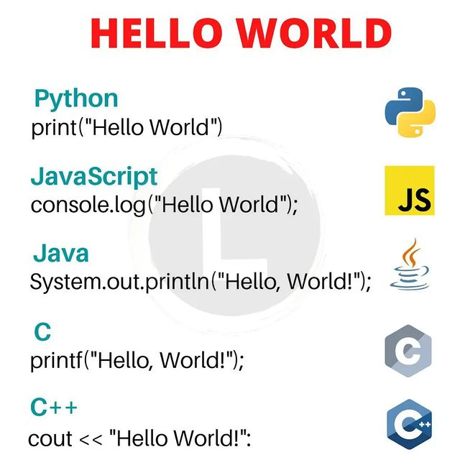

Slide 7
Intro to Software
UI - user Interface Backend Technologies DB - Sql.Nosql
HTML,CSS,JS,TS,Angular
React
Java
.Net
C,C++
Python
Ruby
Scala
R
Mysql,Oracle
Apache Cassandra
Mongo DB
AWS
Docker
Kubernates
IBM WebSphere
Maven
GIT/BitBucket
Jenkins/Puppet
U-deploy
HPE Fortify/BlackDuck

Slide 8
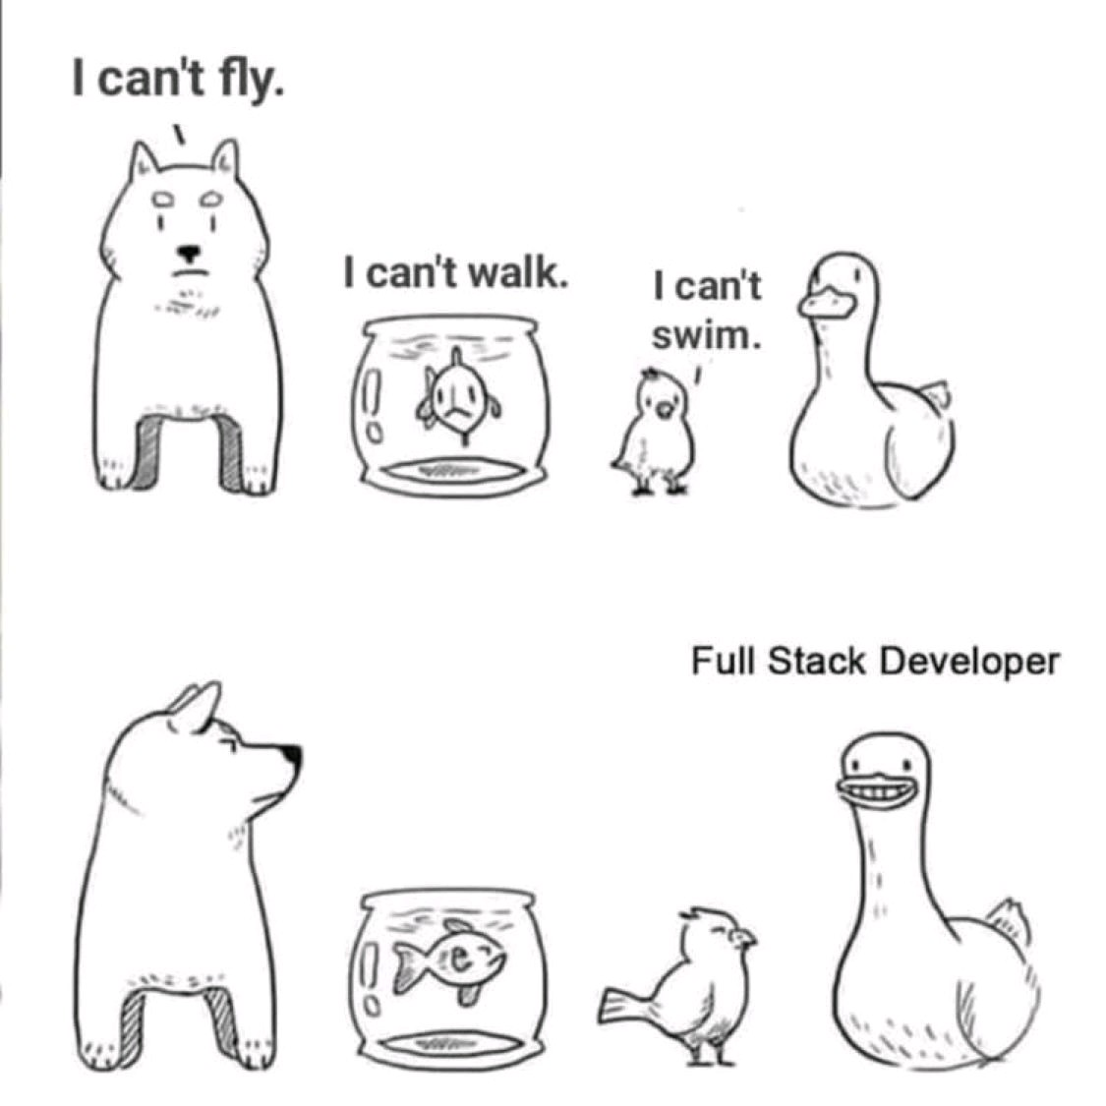

Slide 9
JUST FOR FUN :)
https://github.com/ragaPriya224/hcl-basic_C/blob/master/Programmer_dictionary_beginner.pdf

Slide 10
SYMBOLS - USED
https://github.com/ragaPriya224/hcl-basic_C/blob/master/symbols_programming_.jpg

Slide 11
Basic intro
https://github.com/ragaPriya224/hcl-basic_C/blob/master/BASIC-C.pdf

Slide 12
High level language?
languages are considered high-level because they are closer to human languages high-level languages are easier to grasp. It allows a programmer to write code more efficiently.

Slide 13
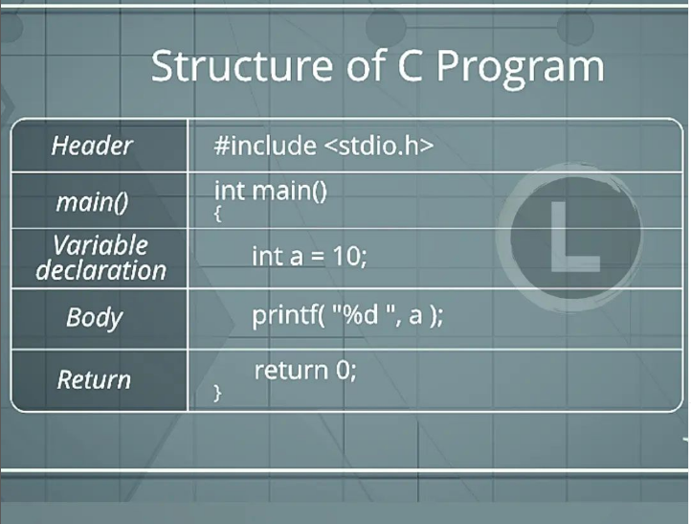
STRUCTURE OF C
Structure of a C program👇
1)Header Files Inclusion,
2)Main Method Declaration,
3)Variable Declaration,
4)Body,
5)Return Statemen.
By structure, it is meant that any program can be written in this structure only. Writing a C program in any other structure will hence lead to compilation error.

Slide 14
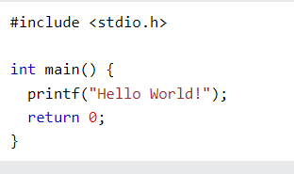
Example explained
Line 1: #include <stdio.h> is a header file library that lets us work with input and output functions, such as printf() (used in line 4). Header files add functionality to C programs.
Don't worry if you don't understand how #include <stdio.h> works. Just think of it as something that (almost) always appears in your program.
Line 2: A blank line. C ignores white space. But we use it to make the code more readable.
Line 3: Another thing that always appear in a C program, is main(). This is called a function. Any code inside its curly brackets {} will be executed.
Line 4: printf() is a function used to output/print text to the screen. In our example it will output "Hello World".
Note that: Every C statement ends with a semicolon ;
#include <stdio.h>
int main() {
printf("Hello World!");
return 0;
}

Slide 15
Line 5: return 0 ends the main() function.
Line 6: Do not forget to add the closing curly bracket } to actually end the main function.

Slide 16
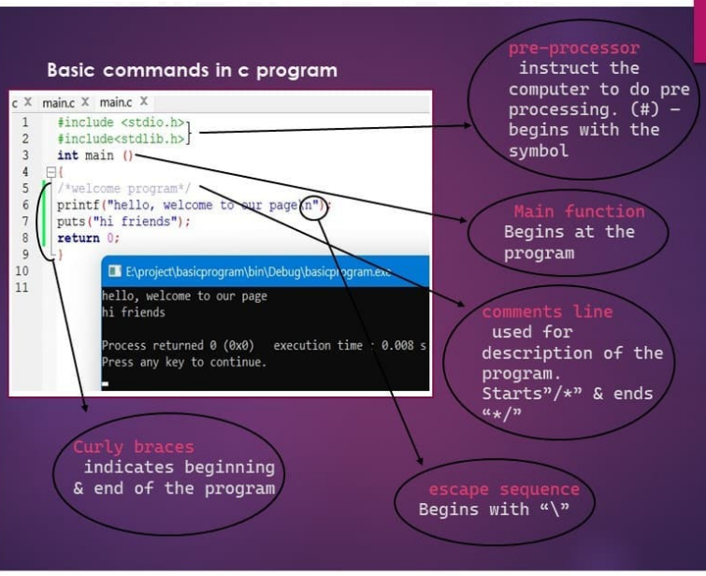

Slide 17
Exercise: -main function
https://www.w3schools.com/c/exercise.php?filename=exercise_syntax1

Slide 18
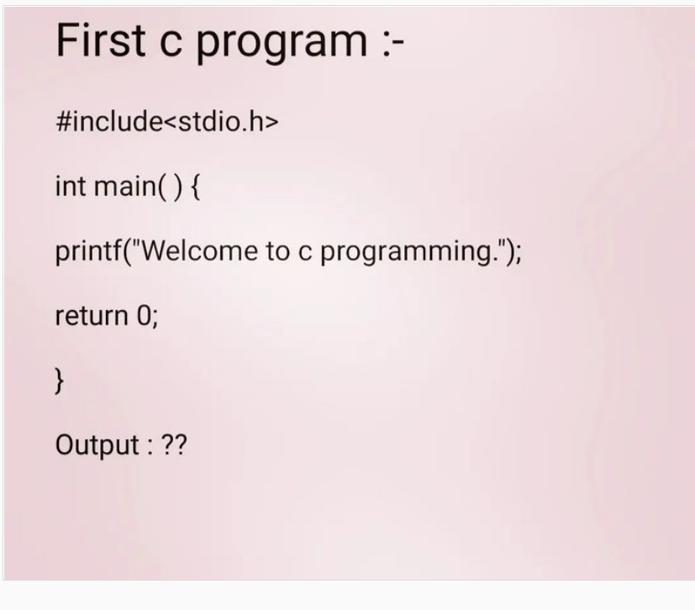

Slide 19
comments

Slide 20
C Variables
variables are containers for storing data values.
In C, there are different types of variables (defined with different keywords), for example:
int - stores integers (whole numbers), without decimals, such as 123 or -123
float - stores floating point numbers, with decimals, such as 19.99 or -19.99
char - stores single characters, such as 'a' or 'B'. Char values are surrounded by single quotes

Slide 21


Slide 22
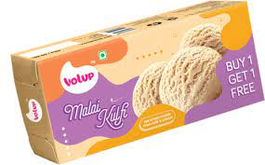
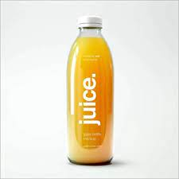
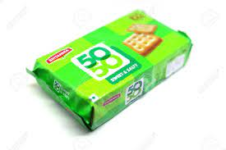
Data Types
Int, float , char

Slide 23
int pen = 10;
Syntax: type variableName = value;
Int -> data type
Pen -> variable
= -> assigning
10 ->value
; -> end of statement

Slide 24
Coding standards:
{
Names
int a,b,c

Slide 25
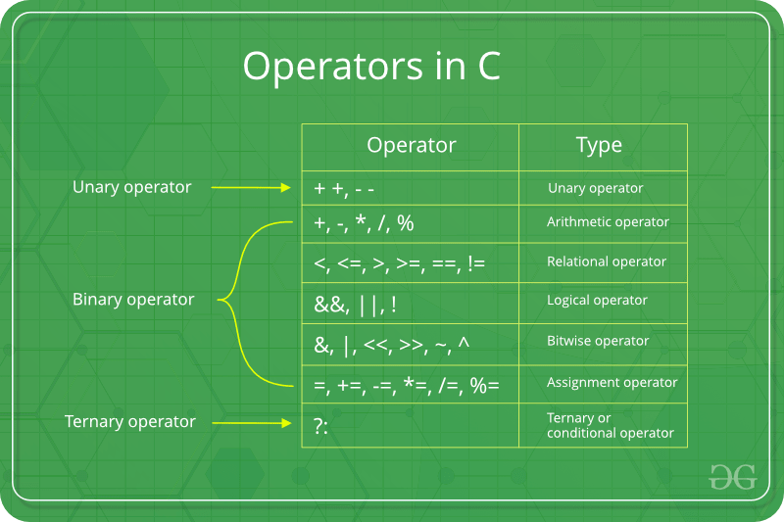

Slide 26
RELATIONAL:
Exercise:
exercise: check according to age, someone is eligble to vote or not

Slide 27
ARITHMETIC OPERATORS

Slide 28
Assignment
// Online C compiler to run C program online
#include <stdio.h>
int main() {
// Write C code here
printf("Hello world");
int a = 10;
//int b = a+5; // 15
//a = a+5; //15
a+=5; //15
return 0;
}

Slide 29
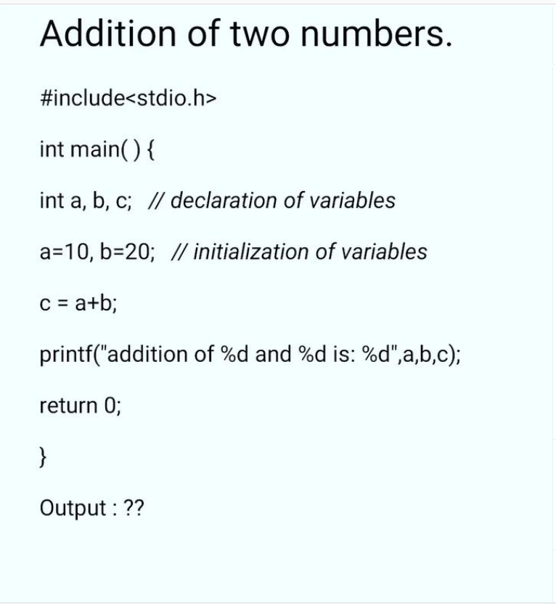
task

Slide 30
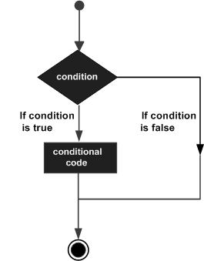
Decision making

Slide 31
FLOW CONTROL

Slide 32

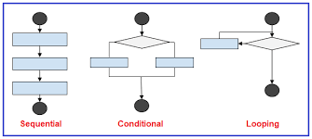
FLOW CONTROL
Selection Iterative Transfer
if else else if while() break
switch() do while() continue
for return

Slide 33
if statement
// if it's saturday or sunday, i have to print it's weekend ;)
// if it's other days, i have to print, it's weekday :(
if (condition) {
// block of code to be executed if the condition is true
}

Slide 34
task
you have 100 rupee, and your favourite icecream is 50 rupee. Write a logic to find whether you’ll be able to buy a icecream or not. If yes, print , “yummy”, if no, print, “let me buy next time”
if it’s sunday, print weekend
if that is not the case, print BORING

Slide 35
nested if problem
Try affording an iphone of 50k.
If not, try afford a redmi of 25k
If not, try buying normal nokia set of 2k
If not, return home

Slide 36
Conditional
if(mark > 50){
printf("pass");
}else{
printf("fail");
}
(mark > 50) ? printf("pass") : printf("fail");
condition ? expression1 : expression2;

Slide 37
switch(expression) {
case x:
// code block
break;
case y:
// code block
break;
default:
// code block
}
int main() {
int mark = 90;
switch(mark) {
case 90:
case 80:
printf("excellent");
break;
case 70:
printf("grade c ");
break;
case 60:
printf("grade d ");
break;
default:
printf("none matched");
}
return 0;
}

Slide 38
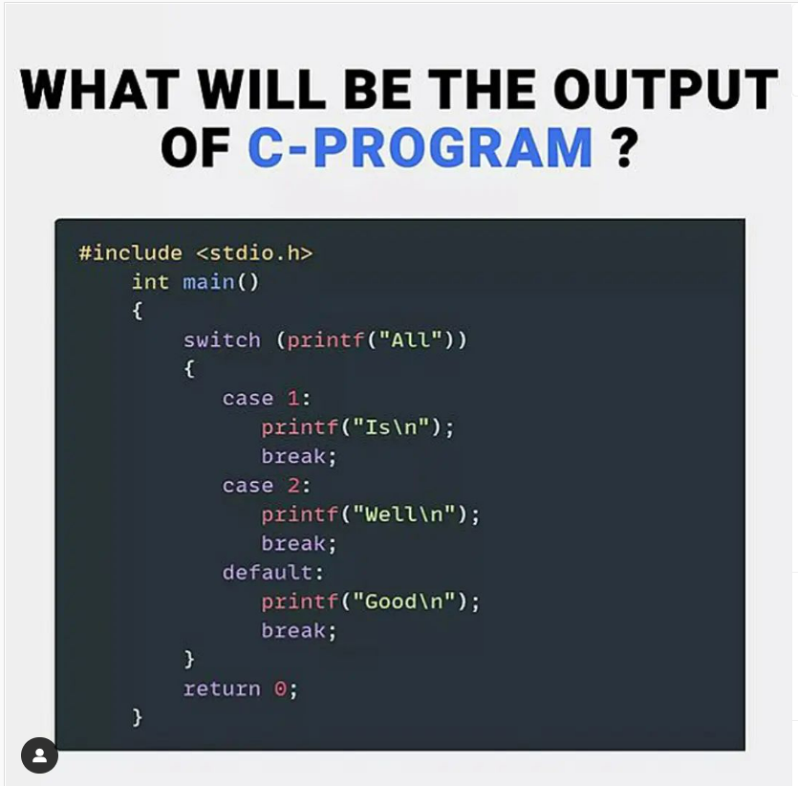
task:
Have a variable day of datatype int.
Write a switch case,such that if it’s day 1, then output should be monday, day 2 -> tuesday like that till day 7.. Suppose if you any number other than these, print “give a valid input”

Slide 39
while loop syntax
Code ref
while (condition) {
// code block to be executed
}
int main() {
int number = 10;
while (number < 5) {
printf("hello buddy");
number++;
}
printf("bye!");
return 0;
}

Slide 40
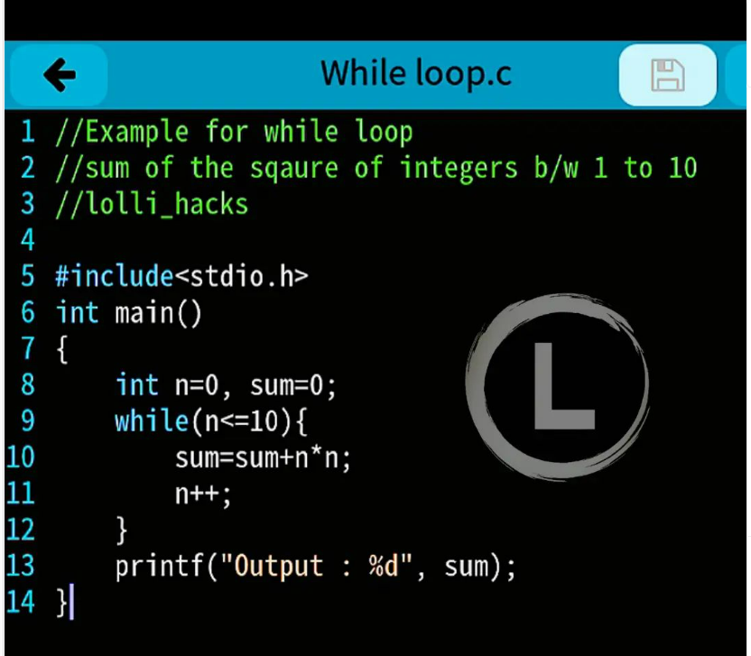

Slide 41
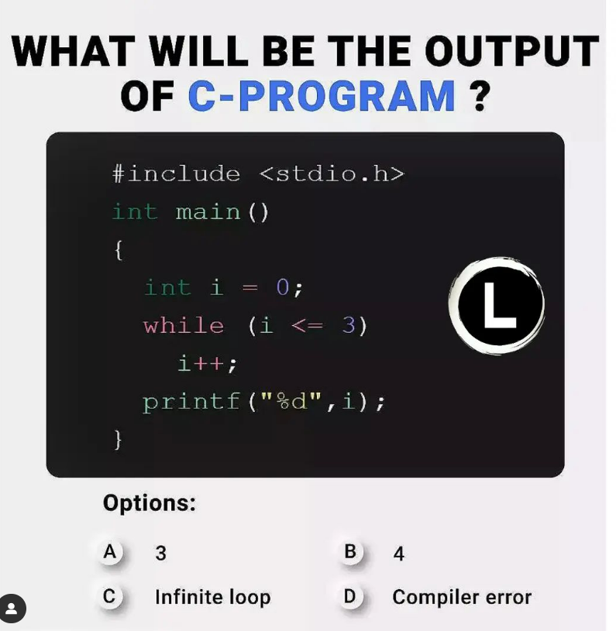
task

Slide 42
do while loop syntax
int main() {
int number = 10;
do {
printf("hello aliens");
number++;
}
while (number<5);
return 0;
}
do {
// code block to be executed
}
while (condition);

Slide 43
For loop
for(initialization; condition; increment/decrement){
//statement or code to be executed
}

Slide 44
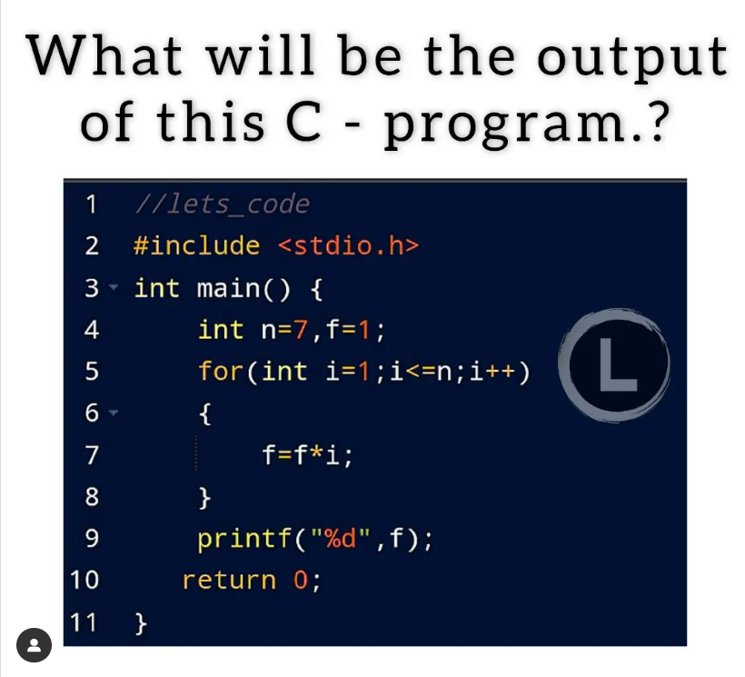

Slide 45
Continue
int main() {
int num = 1;
while(num < 5){
if(num == 3){
printf("weekend ");
num++;
continue;
}else{
num++;
}
printf("good ");
}
return 0;
}

Slide 46
FUNCTIONS

Slide 47
POINTS TO COVER:
What? 2. Definition, call, declare 3.
Multiple times, diff return types, parameter any…std

Slide 48
SYNTAX
returnType functionName(parameter1, parameter2, parameter3) {
// code to be executed
}
// parameters optional
Meaningful function names to be given

Slide 49
FUNCTIONS
file:///D:/AHCL/FUNCTIONS_c.pdf

Slide 50
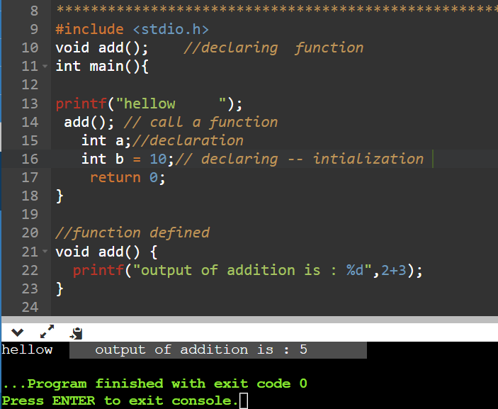
Function - without parameters, void r type
#include <stdio.h>
void add(); //declaring function
int main(){
printf("hellow ");
add(); // call a function
int a;//declaration
int b = 10;// declaring -- intialization
return 0;
}
//function defined
void add() {
printf("output of addition is : %d",2+3);
}

Slide 51
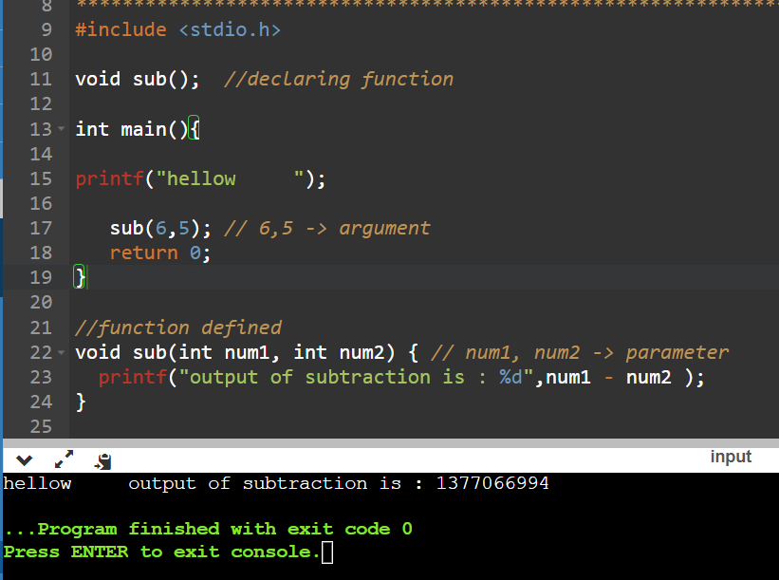
Function -> with parameters, void return type
#include <stdio.h>
void sub(); //declaring function
int main(){
printf("hellow ");
sub(6,5); // 6,5 -> argument
return 0;
}
//function defined
void sub(int num1, int num2) { // num1, num2 -> parameter
printf("output of subtraction is : %d",num1 - num2 );
}

Slide 52
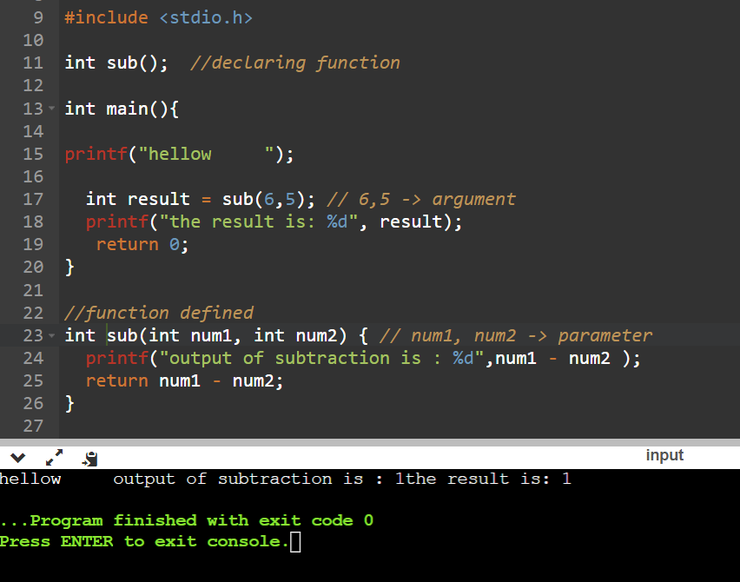
function-> with parameters, with return type
#include <stdio.h>
int sub(); //declaring function
int main(){
printf("hellow ");
int result = sub(6,5); // 6,5 -> argument
printf("the result is: %d", result);
return 0;
}
//function defined
int sub(int num1, int num2) { // num1, num2 -> parameter
printf("output of subtraction is : %d",num1 - num2 );
return num1 - num2;
}

Slide 53
Task:
create a function to multiply two numbers and return it

Slide 54
ARRAYS

Slide 55
ARRAY
int myNumbers[] = {25, 50, 75, 100};
Access the Elements of an Array
Change an Array Element
Loop Through an Array
4.Set Array Size
MISC: CAN’T CHANGE , index

Slide 56
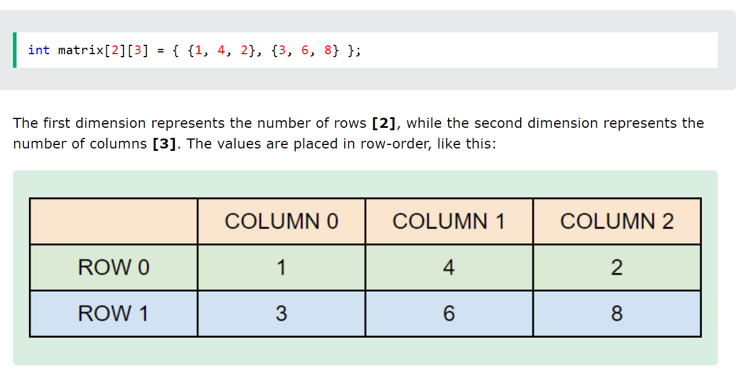
2D

Slide 57
Creation
Access
Change
loop

Slide 58
STRING

Slide 59
STRING?
The string can be defined as the one-dimensional array of characters terminated by a null ('\0'). The character array or the string is used to manipulate text such as word or sentences. Each character in the array occupies one byte of memory, and the last character must always be 0. The termination character ('\0') is important in a string since it is the only way to identify where the string ends. When we define a string as char s[10], the character s[10] is implicitly initialized with the null in the memory.

Slide 60
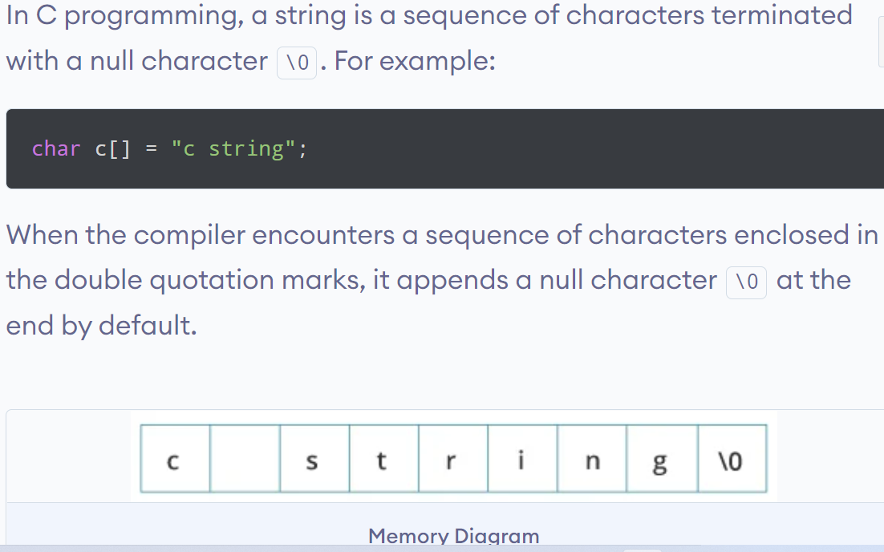

Slide 61
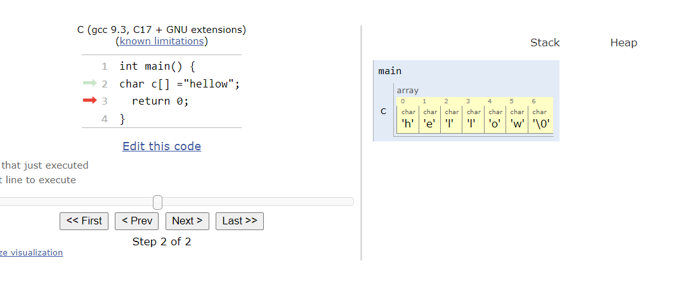

Slide 62
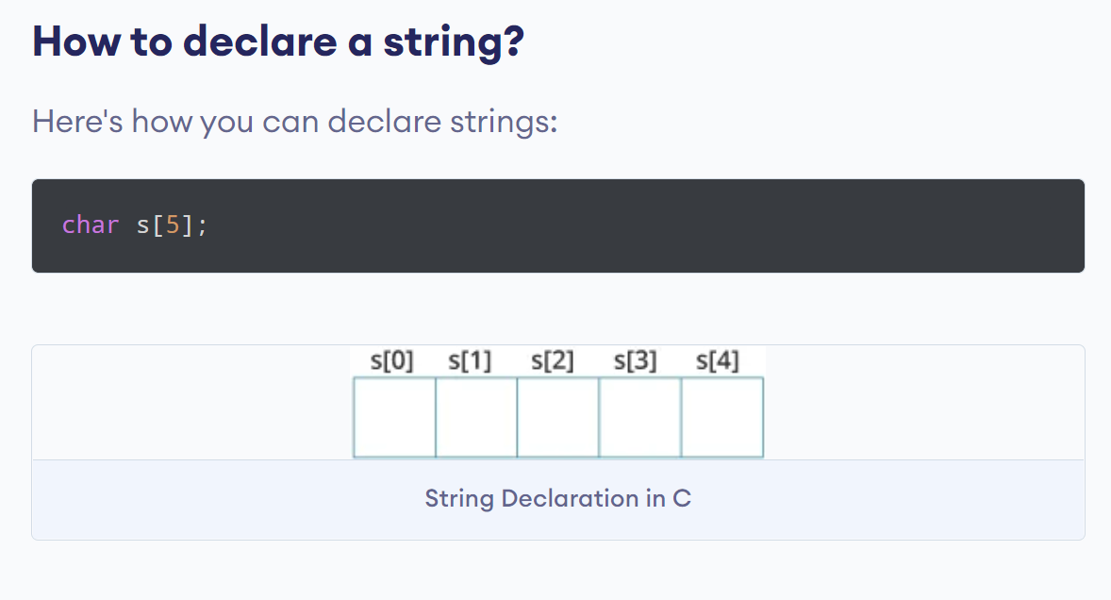
declaration

Slide 63
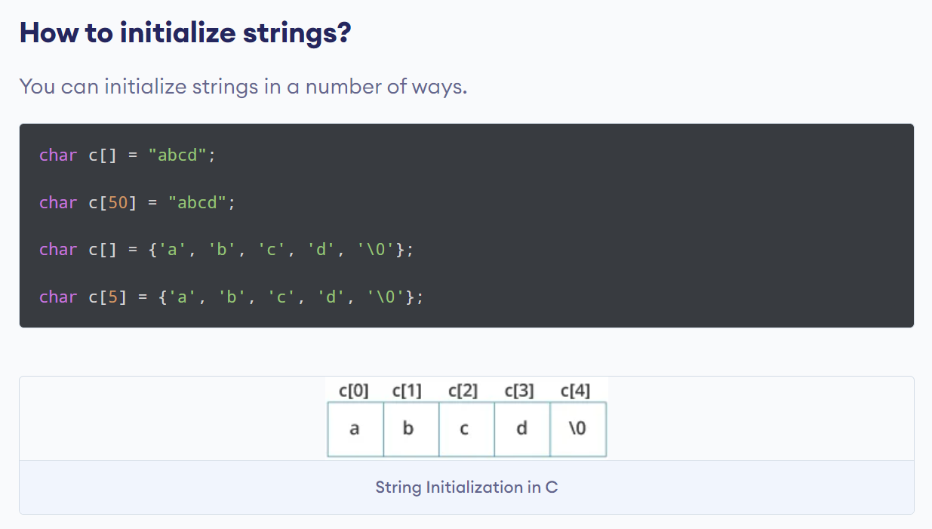
initialize

Slide 64
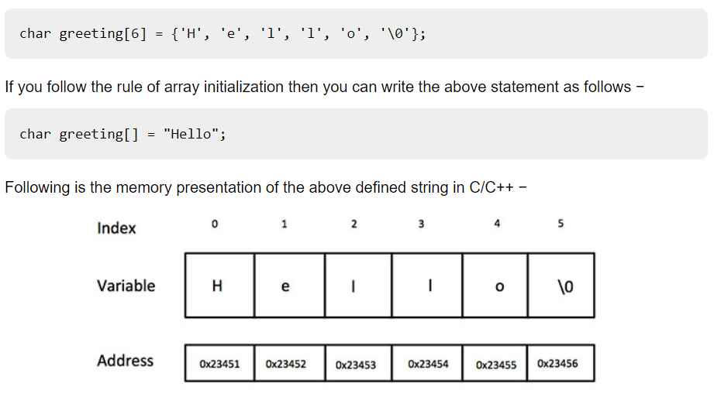

Slide 65
2 ways
By char array
By string literal

Slide 66
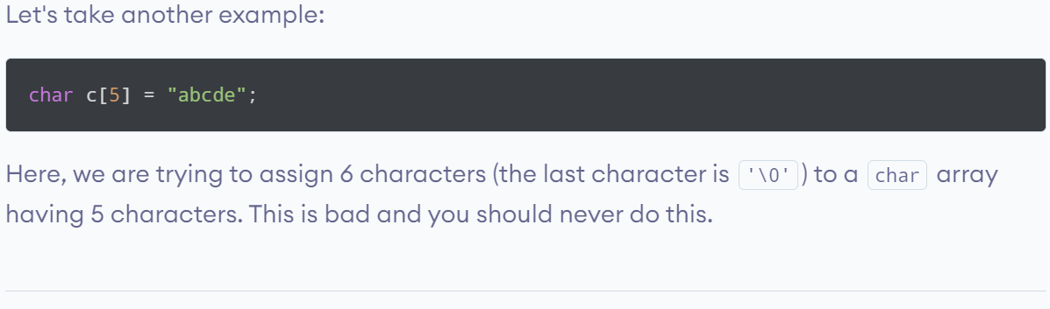
Bad practice

Slide 67
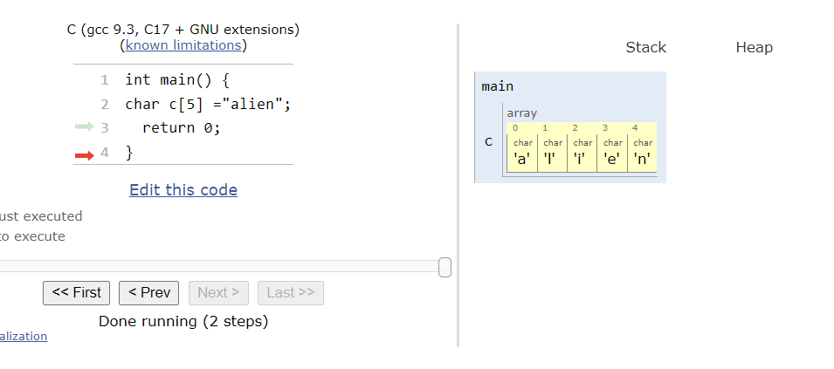

Slide 68
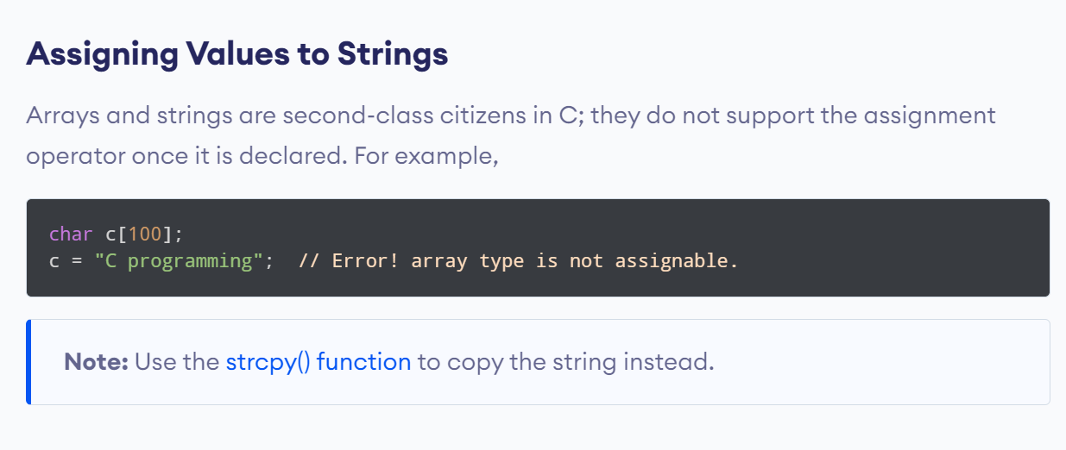
Bad practice

Slide 69
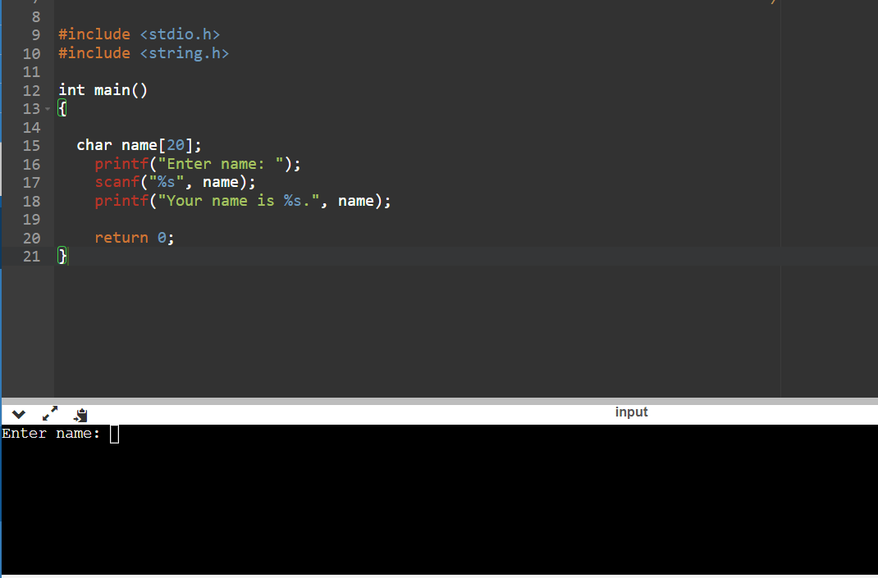
Scanf - intro

Slide 70
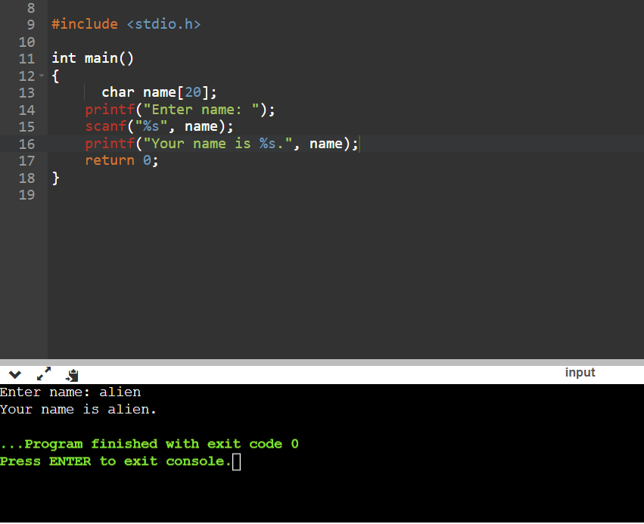
contd…
#include <stdio.h>
int main()
{
char name[20];
printf("Enter name: ");
scanf("%s", name);
printf("Your name is %s.", name);
return 0;
}

Slide 71
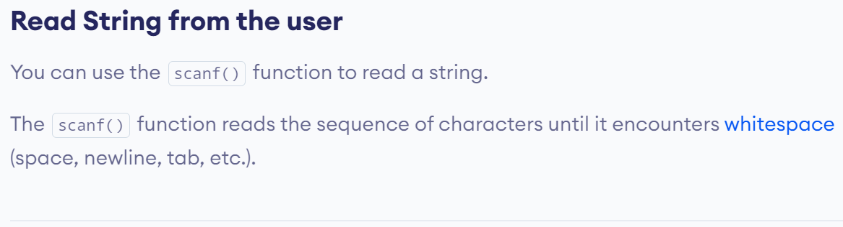

Slide 72
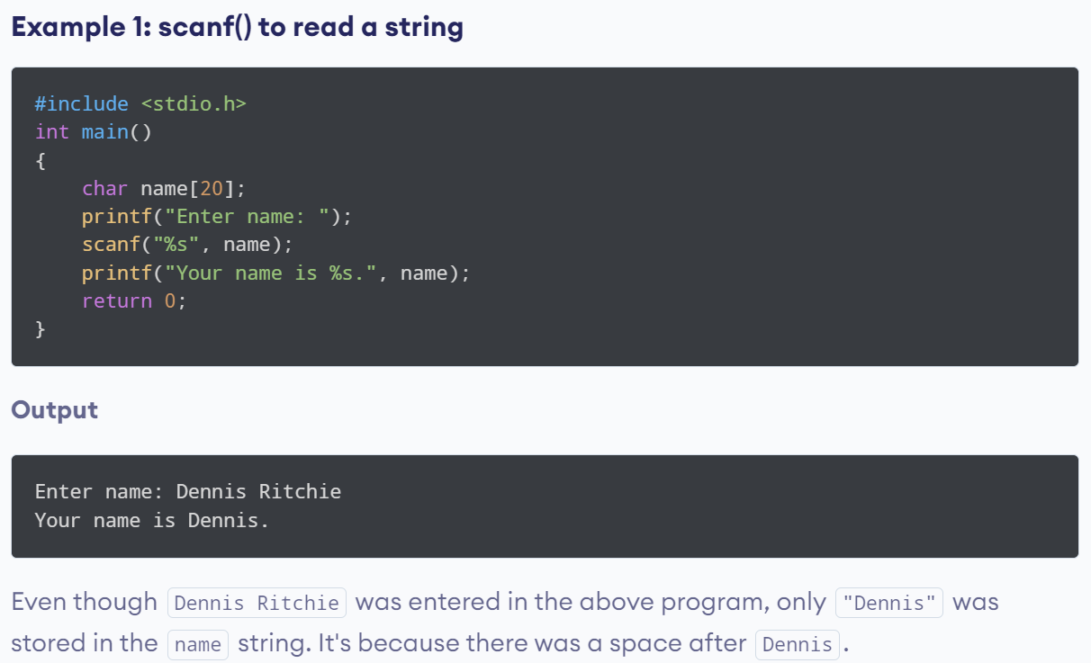
issue
char name[20];
printf("Enter name: ");
scanf("%s", name);
printf("Your name is %s.", name);

Slide 73
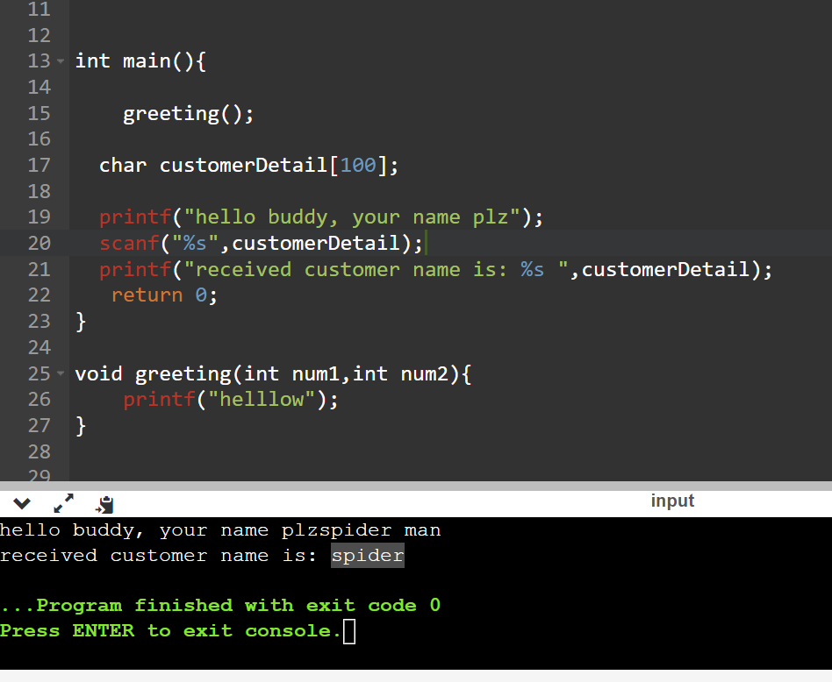
SAME ISSUE ANOTHER EXAMPLE

Slide 74
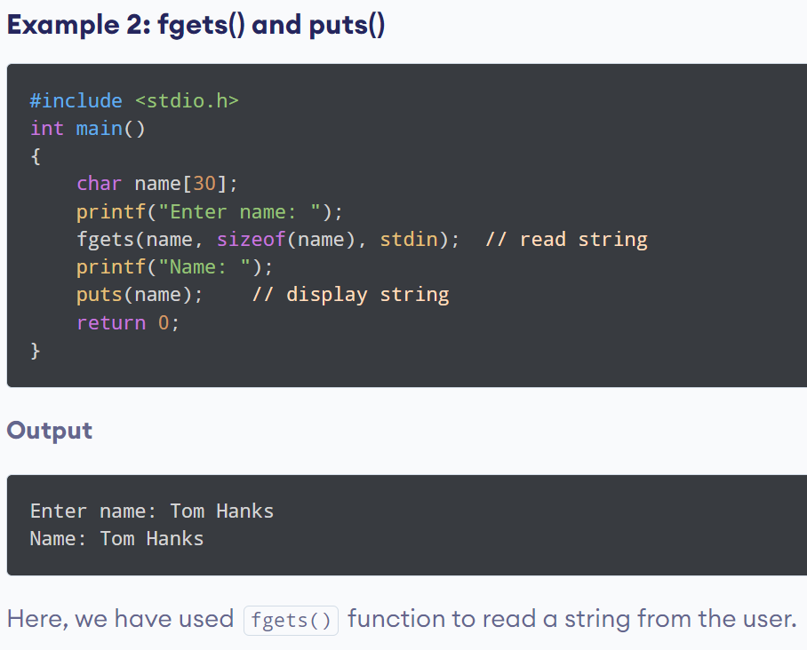
#include <stdio.h>
int main()
{
char name[30];
printf("Enter name: ");
fgets(name, sizeof(name), stdin); // read string
printf("Name: ");
puts(name); // display string
return 0;
}

Slide 75
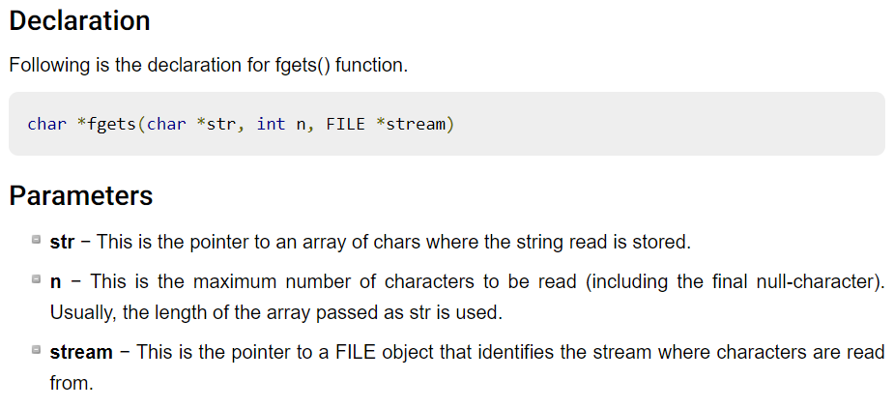

Slide 76
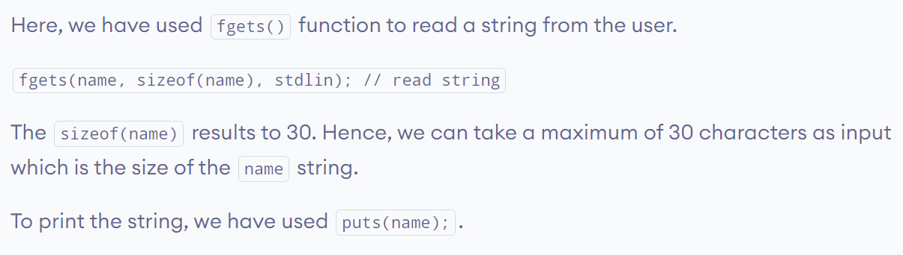
NOTE:
gets() -> not a standard
stdin is an "input stream", which is an abstract term for something that takes input from the user or from a file

Slide 77
sizeof()
code
#include <stdio.h>
int main() {
int a = 16;
printf("Size of variable a : %d",sizeof(a));
printf("Size of int data type : %d",sizeof(int));
printf("Size of char data type : %d",sizeof(char));
printf("Size of float data type : %d",sizeof(float));
printf("Size of double data type : %d",sizeof(double)); printf("Size of a+2 is : %d",sizeof(a+2));
return 0;
}
output
Size of variable a : 4
Size of int data type : 4
Size of char data type : 1
Size of float data type : 4
Size of double data type : 8 Size of a+2 is : 4

Slide 78
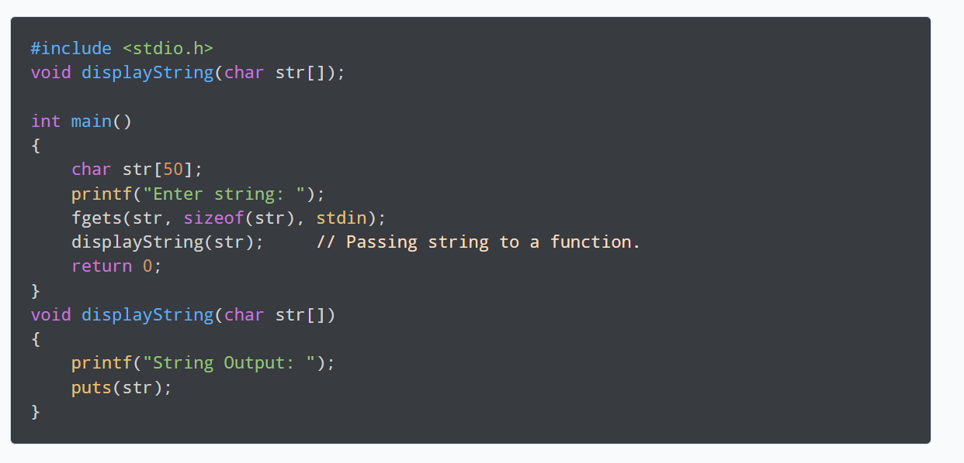
PASS STRING TO FUNCTION

Slide 79
STRING MANIPULATIONS
strlen() - calculates the length of a string
strcpy() - copies a string to another
strcmp() - compares two strings
strcat() - concatenates two strings

Slide 80
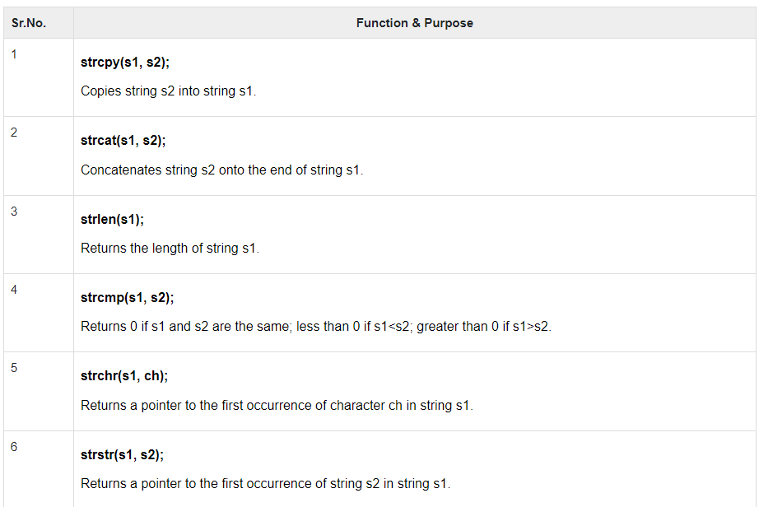

Slide 81
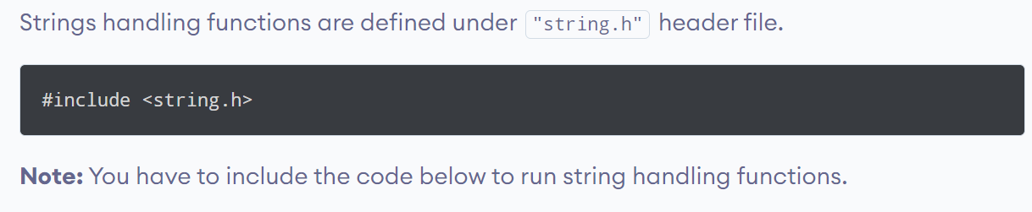

Slide 82
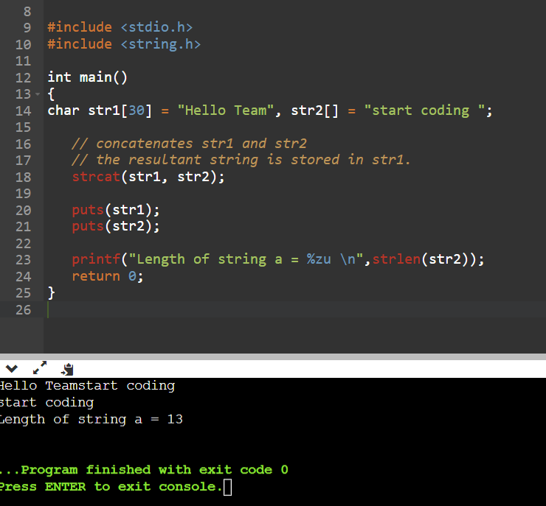
strcat() -> concatenation - joins
#include <stdio.h>
#include <string.h>
int main()
{
char str1[30] = "Hello Team", str2[] = "start coding ";
// concatenates str1 and str2
// the resultant string is stored in str1.
strcat(str1, str2);
puts(str1);
puts(str2);
printf("Length of string a = %zu \n",strlen(str2));
return 0;
}

Slide 83
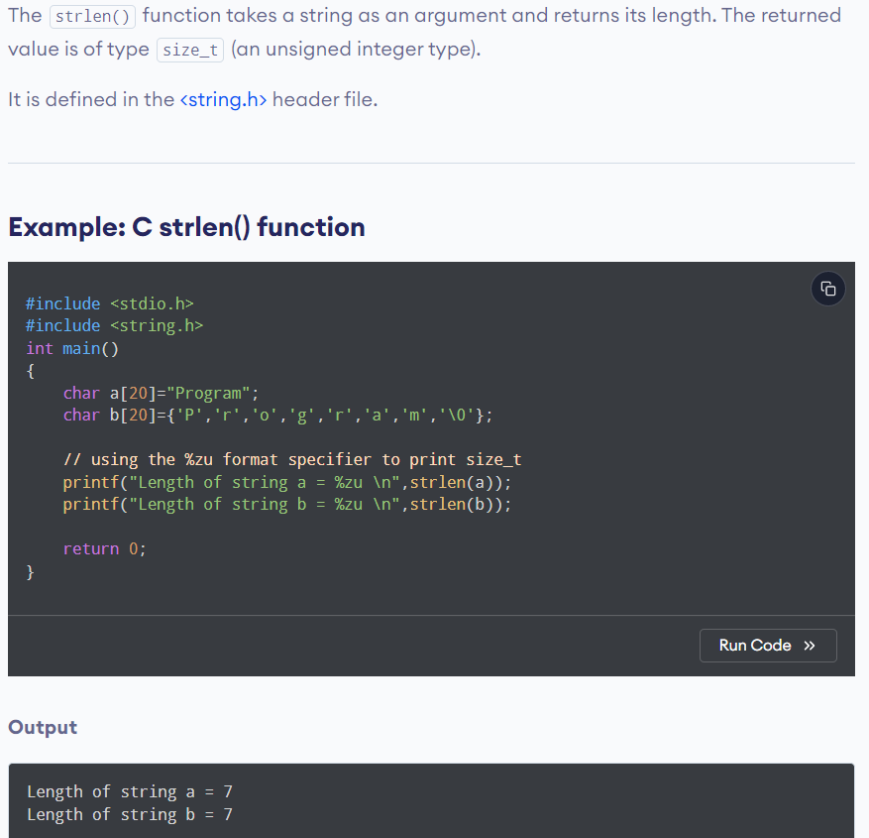
strlen() Note that the strlen() function doesn't count the null character \0 while calculating the length.
#include <stdio.h>
#include <string.h>
int main()
{
char a[20]="Program";
char b[20]={'P','r','o','g','r','a','m','\0'};
// using the %zu format specifier to print size_t
printf("Length of string a = %zu \n",strlen(a));
printf("Length of string b = %zu \n",strlen(b));
return 0;
}

Slide 84
Y zu?
https://www.tutorialspoint.com/what-is-the-correct-way-to-use-printf-to-print-a-size-t-in-c-cplusplus

Slide 85
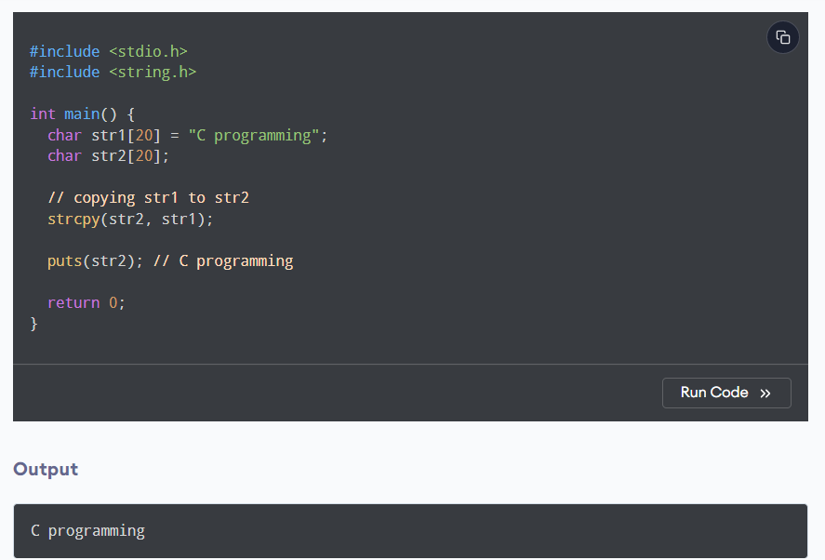
strcpy() ->copy string
strcpy(destination, source);
Note: When you use strcpy(), the size of the destination string should be large enough to store the copied string. Otherwise, it may result in undefined behavior
#include <stdio.h>
#include <string.h>
int main() {
char str1[20] = "C programming";
char str2[20];
// copying str1 to str2
strcpy(str2, str1);
puts(str2); // C programming
return 0;
}

Slide 86
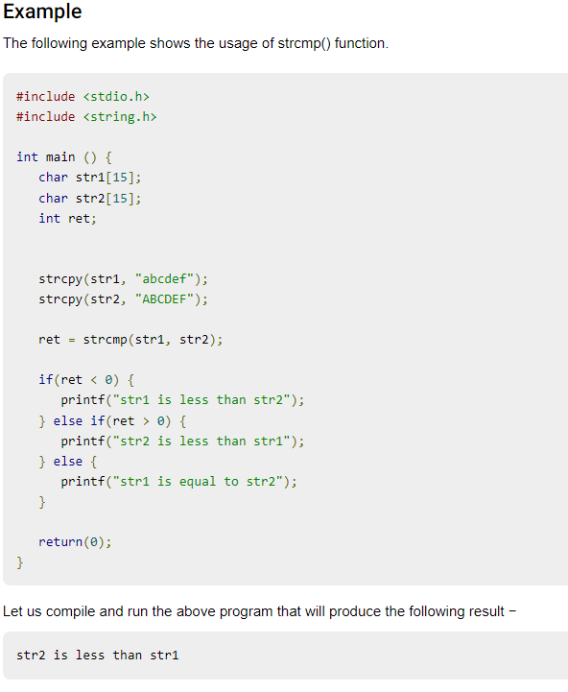
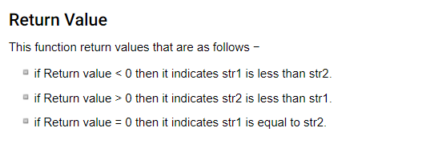
strcmp() -> compare

Slide 87
code
#include <stdio.h>
#include <string.h>
int main () {
char str1[15];
char str2[15];
int ret;
strcpy(str1, "abcdef");
strcpy(str2, "ABCDEF");
ret = strcmp(str1, str2);
if(ret < 0) {
printf("str1 is less than str2");
} else if(ret > 0) {
printf("str2 is less than str1");
} else {
printf("str1 is equal to str2");
}
return(0);
}

Slide 88
Bitwise Operator in C
The bitwise operators are the operators used to perform the operations on the data at the bit-level. When we perform the bitwise operations, then it is also known as bit-level programming. It consists of two digits, either 0 or 1. It is mainly used in numerical computations to make the calculations faster.

Slide 89
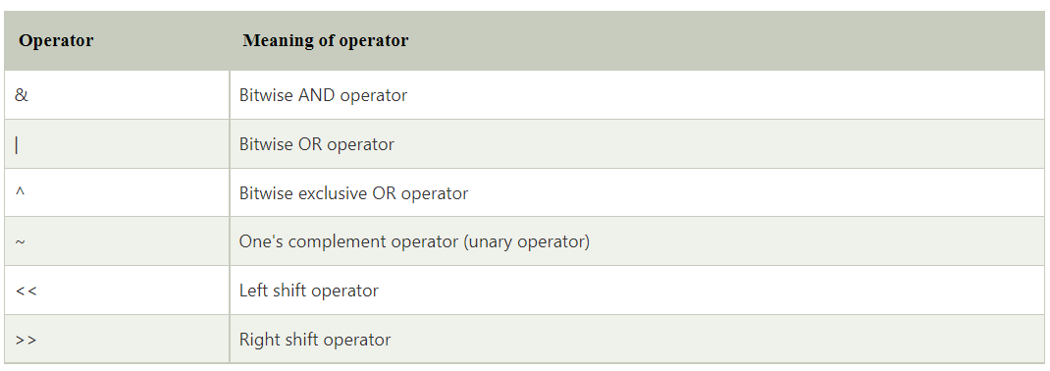

Slide 90
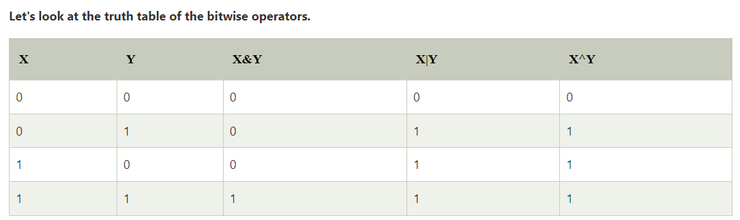

Slide 91
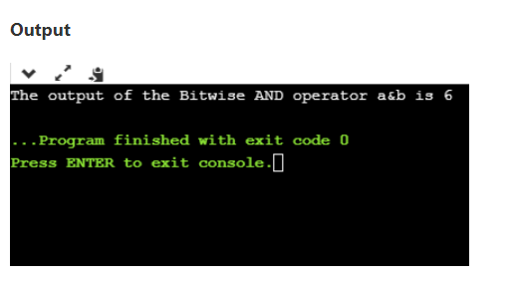
Bitwise AND operator
#include <stdio.h>
int main()
{
int a=6, b=14; // variable declarations
printf("The output of the Bitwise AND operator a&b is %d",a&b);
return 0;
}
in the above code, we have created two variables, i.e., 'a' and 'b'. The values of 'a' and 'b' are 6 and 14 respectively. The binary value of 'a' and 'b' are 0110 and 1110, respectively. When we apply the AND operator between these two variables,
a AND b = 0110 & 1110 = 0110

Slide 92
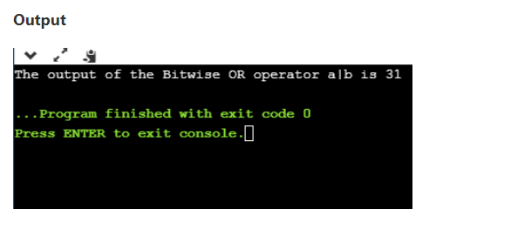
bitwise OR operator
#include <stdio.h>
int main()
{
int a=23,b=10; // variable declarations
printf("The output of the Bitwise OR operator a|b is %d",a|b);
return 0;
}
We consider two variables,
a = 23;
b = 10;
The binary representation of the above two variables would be:
a = 0001 0111
b = 0000 1010
When we apply the bitwise OR operator in the above two variables, i.e., a|b , then the output would be:
Result = 0001 1111

Slide 93

Bitwise exclusive OR operator
Bitwise exclusive OR operator is denoted by (^) symbol. Two operands are written on both sides of the exclusive OR operator. If the corresponding bit of any of the operand is 1 then the output would be 1, otherwise 0.
#include <stdio.h>
int main()
{
int a=12,b=10; // variable declarations
printf("The output of the Bitwise exclusive OR operator a^b is %d",a^b);
return 0;
}
We consider two variables a and b,
a = 12;
b = 10;
The binary representation of the above two variables would be:
a = 0000 1100
b = 0000 1010
When we apply the bitwise exclusive OR operator in the above two variables (a^b), then the result would be:
Result = 0000 1110

Slide 94

Bitwise complement operator
The bitwise complement operator is also known as one's complement operator. It is represented by the symbol tilde (~).
It takes only one operand or variable and performs complement operation on an operand. When we apply the complement operation on any bits, then 0 becomes 1 and 1 becomes 0.
If we have a variable named 'a',
a = 8;
The binary representation of the above variable is given below:
a = 1000
When we apply the bitwise complement operator to the operand, then the output would be:
Result = 0111
#include <stdio.h>
int main()
{
int a=8; // variable declarations
printf("The output of the Bitwise complement operator ~a is %d",~a);
return 0;
}

Slide 95
Bitwise shift operators
The bitwise shift operators will shift the bits either on the left-side or right-side. Therefore, we can say that the bitwise shift operator is divided into two categories:
Left-shift operator
Right-shift operator
The << (left shift) in C or C++ takes two numbers, left shifts the bits of the first operand, the second operand decides the number of places to shift.
The >> (right shift) in C or C++ takes two numbers, right shifts the bits of the first operand, the second operand decides the number of places to shift.

Slide 96
// The result is 00010010
printf("b<<1 = %d\n", b << 1);
// The result is 00000100
printf("b>>1 = %d\n", b >> 1);
OUTPUT:
b << 1 = 18
b >> 1 = 4

Slide 97
Types of Variables in C
local variable
global variable
static variable
automatic variable
external variable

Slide 98

STATIC VARIABLE->A variable that is declared with the static keyword is called static variable.
It retains its value between multiple function calls.
#include <stdio.h>
int main()
{
function1();
function1();
function1();
return 0;
}
void function1(){
int x=10;//local variable
static int y=10;//static variable
x=x+1;
y=y+1;
printf("%d,%d",x,y);
}
If you call this function many times, the local variable will print the same value for each function call, e.g, 11,11,11 and so on. But the static variable will print the incremented value in each function call, e.g. 11, 12, 13 and so on.

Slide 99
Global Variable
A variable that is declared outside the function or block is called a global variable. Any function can change the value of the global variable. It is available to all the functions.
It must be declared at the start of the block.
int value=20;//global variable
void function1(){
int x=10;//local variable
}

Slide 100
EXTERN - We can share a variable in multiple C source files by using an external variable. To declare an external variable, you need to use extern keyword
myfile.h
program1.c
extern int x=10;//external variable (also global)
#include "myfile.h"
#include <stdio.h>
void printValue(){
printf("Global variable: %d", global_variable);
}

Slide 101

Memory Address
When a variable is created in C, a memory address is assigned to the variable.
The memory address is the location of where the variable is stored on the computer.
When we assign a value to the variable, it is stored in this memory address.
To access it, use the reference operator (&), and the result will represent where the variable is stored:

Slide 102

You should also note that &myAge is often called a "pointer".
A pointer basically stores the memory address of a variable as its value. To print pointer values, we use the %p format specifier.
int myAge = 43;
// an int variable
printf("%d", myAge);
// Outputs the value of myAge (43)
printf("%p", &myAge);
// Outputs the memory address of myAge (0x7ffe5367e044)

Slide 103
In the example above, &myAge is also known as a pointer.
A pointer is a variable that stores the memory address of another variable as its value.
A pointer variable points to a data type (like int) of the same type, and is created with the * operator. The address of the variable you are working with is assigned to the pointer:

Slide 104
int myAge = 43; // An int variable
int* ptr = &myAge; // A pointer variable, with the name ptr, that stores the address of myAge
// Output the value of myAge (43)
printf("%d\n", myAge);
// Output the memory address of myAge (0x7ffe5367e044)
printf("%p\n", &myAge);
// Output the memory address of myAge with the pointer (0x7ffe5367e044)
printf("%p\n", ptr);
Example explained
Create a pointer variable with the name ptr, that points to an int variable (myAge). Note that the type of the pointer has to match the type of the variable you're working with.
Use the & operator to store the memory address of the myAge variable, and assign it to the pointer.
Now, ptr holds the value of myAge's memory address

Slide 105
Dereference
you can also get the value of the variable the pointer points to, by using the * operator (the dereference operator):
int myAge = 43; // Variable declaration
int* ptr = &myAge; // Pointer declaration
// Reference: Output the memory address of myAge with the pointer (0x7ffe5367e044)
printf("%p\n", ptr);
// Dereference: Output the value of myAge with the pointer (43)
printf("%d\n", *ptr);
Note that the * sign can be confusing here, as it does two different things in our code:
When used in declaration (int* ptr), it creates a pointer variable.
When not used in declaration, it act as a dereference operator

Slide 106


Slide 107
task:
Create a pointer variable called ptr, that points to the int variable myAge:
int myAge = 43;
= &myAge;
Create a pointer variable called ptr, that points to the int variable myAge:
int myAge = 43;
int* ptr = &myAge;

Slide 108
C - Pointer arithmetic
you can perform arithmetic operations on a pointer just as you can on a numeric value. There are four arithmetic operators that can be used on pointers: ++, --, +, and - To understand pointer arithmetic, let us consider that ptr is an integer pointer which points to the address 1000. Assuming 32-bit integers, let us perform the following arithmetic operation on the pointer −
ptr++
After the above operation, the ptr will point to the location 1004 because each time ptr is incremented, it will point to the next integer location which is 4 bytes next to the current location. This operation will move the pointer to the next memory location without impacting the actual value at the memory location. If ptr points to a character whose address is 1000, then the above operation will point to the location 1001 because the next character will be available at 1001.
#include <stdio.h>
const int MAX = 3;
int main () {
int var[] = {10, 100, 200};
int i, *ptr;
/* let us have array address in pointer */
ptr = var;
for ( i = 0; i < MAX; i++) {
printf("Address of var[%d] = %x\n", i, ptr );
printf("Value of var[%d] = %d\n", i, *ptr );
/* move to the next location */
ptr++;
}
return 0;
}

Slide 109


Slide 110

Decrementing a Pointer

Slide 111
Pointer Comparisons
Pointers may be compared by using relational operators, such as ==, <, and >. If p1 and p2 point to variables that are related to each other, such as elements of the same array, then p1 and p2 can be meaningfully compared.
The following program modifies the previous example − one by incrementing the variable pointer so long as the address to which it points is either less than or equal to the address of the last element of the array, which is &var[MAX - 1] −

Slide 112

#include <stdio.h>
const int MAX = 3;
int main () {
int var[] = {10, 100, 200};
int i, *ptr;
/* let us have address of the first element in pointer */
ptr = var;
i = 0;
while ( ptr <= &var[MAX - 1] ) {
printf("Address of var[%d] = %x\n", i, ptr );
printf("Value of var[%d] = %d\n", i, *ptr );
/* point to the next location */
ptr++;
i++;
}
return 0;
}

Slide 113
REFEREnce:
https://www.tutorialspoint.com/cprogramming/c_pointer_arithmetic.htm

Slide 114
C - Command Line Arguments
It is possible to pass some values from the command line to your C programs when they are executed.
These values are called command line arguments and many times they are important for your program especially when you want to control your program from outside instead of hard coding those values inside the code.
The command line arguments are handled using main() function arguments where argc refers to the number of arguments passed, and argv[] is a pointer array which points to each argument passed to the program

Slide 115

It should be noted that argv[0] holds the name of the program itself and argv[1] is a pointer to the first command line argument supplied, and *argv[n] is the last argument. If no arguments are supplied, argc will be one, and if you pass one argument then argc is set at 2.
#include <stdio.h>
int main( int argc, char *argv[] ) {
if( argc == 2 ) {
printf("The argument supplied is %s\n", argv[1]);
}
else if( argc > 2 ) {
printf("Too many arguments supplied.\n");
}
else {
printf("One argument expected.\n");
}
}
You pass all the command line arguments separated by a space, but if argument itself has a space then you can pass such arguments by putting them inside double quotes "" or single quote

Slide 116
Intro for struct
Y struct?
In C, there are cases where we need to store multiple attributes of an entity
can have different attributes of different data types.
For example, an entity Student may have its name (string), roll number (int), marks (float).
To store such type of information regarding an entity student, we have the following approaches:
Construct individual arrays for storing names, roll numbers, and marks.
Use a special data structure to store the collection of different data types

Slide 117

The above program may fulfill our requirement of storing the information of an entity student. However, the program is very complex, and the complexity increase with the amount of the input.
C provides you with an additional and simpler approach where you can use a special data structure, i.e., structure, in which, you can group all the information of different data type regarding an entity.

Slide 118

struct

Slide 119

struct employee
{ int id;
char name[10];
float salary;
};

Slide 120


Slide 121

Declaring structure variable
We can declare a variable for the structure so that we can access the member of the structure easily. There are two ways to declare structure variable:
By struct keyword within main() function
By declaring a variable at the time of defining the structure.
1st way:
Let's see the example to declare the structure variable by struct keyword. It should be declared within the main function

Slide 122

2nd way
Which approach is good
If number of variables are not fixed, use the 1st approach.
Else use 2nd approach

Slide 123
CODE EXAMPLE
Accessing members of the structure
There are two ways to access structure members:
By . (member or dot operator)

Slide 124

#include<stdio.h>
#include <string.h>
struct employee
{ int id;
char name[50];
}e1; //declaring e1 variable for structure
int main( )
{
//store first employee information
e1.id=101;
strcpy(e1.name, "Sonoo Jaiswal");//copying string into char array
//printing first employee information
printf( "employee 1 id : %d\n", e1.id);
printf( "employee 1 name : %s\n", e1.name);
return 0;
}

Slide 125

ANOTHER EXAMPLE
#include<stdio.h>
#include <string.h>
struct employee
{ int id;
char name[50];
float salary;
}e1,e2; //declaring e1 and e2 variables for structure
int main( )
{
//store first employee information
e1.id=101;
strcpy(e1.name, "Sonoo Jaiswal");//copying string into char array
e1.salary=56000;
//store second employee information
e2.id=102;
strcpy(e2.name, "James Bond");
e2.salary=126000;
//printing first employee information
printf( "employee 1 id : %d\n", e1.id);
printf( "employee 1 name : %s\n", e1.name);
printf( "employee 1 salary : %f\n", e1.salary);
//printing second employee information
printf( "employee 2 id : %d\n", e2.id);
printf( "employee 2 name : %s\n", e2.name);
printf( "employee 2 salary : %f\n", e2.salary);
return 0;
}

Slide 126
TYPEDEF - https://www.javatpoint.com/typedef-in-c
typedef <existing_name> <alias_name>
In the above syntax, 'existing_name' is the name of an already existing variable while 'alias name' is another name given to the existing variable.
For example, suppose we want to create a variable of type unsigned int, then it becomes a tedious task if we want to declare multiple variables of this type. To overcome the problem, we use a typedef keyword.
typedef unsigned int unit;
In the above statements, we have declared the unit variable of type unsigned int by using a typedef keyword.
Now, we can create the variables of type unsigned int by writing the following statement:
unit a, b;
instead of writing:
unsigned int a, b;

Slide 127

Simple example
#include <stdio.h>
int main()
{
typedef unsigned int unit;
unit i,j;
i=10;
j=20;
printf("Value of i is :%d",i);
printf("\nValue of j is :%d",j);
return 0;
}

Slide 128
Using typedef with structures
struct student
{
char name[20];
int age;
};
struct student s1;
struct student s2;

Slide 129
ANOTHER WAY
ANOTHER WAY
struct student
{
char name[20];
int age;
};
typedef struct student stud;
stud s1, s2;
typedef struct student
{
char name[20];
int age;
} stud;
stud s1,s2;
In the above statement, we have declared the variable stud of type struct student. Now, we can use the stud variable in a program to create the variables of type struct student.
From the above declarations, we conclude that typedef keyword reduces the length of the code and complexity of data types. It also helps in understanding the program.

Slide 130
ANOTHER FULL EXAMPLE
#include <stdio.h>
typedef struct student
{
char name[20];
int age;
}stud;
int main()
{
stud s1;
printf("Enter the details of student s1: ");
printf("\nEnter the name of the student:");
scanf("%s",&s1.name);
printf("\nEnter the age of student:");
scanf("%d",&s1.age);
printf("\n Name of the student is : %s", s1.name);
printf("\n Age of the student is : %d", s1.age);
return 0;
}

Slide 131
Array of structures
struct book{
int pages;
char author [30];
float price;
};
The most common use of structure in C programming is an array of structures.
To declare an array of structure, first the structure must be defined and then an array variable of that type should be defined.
For Example − struct book b[10]; //10 elements in an array of structures of type ‘book’

Slide 132
Array of Structures in C
An array of structres in C can be defined as the collection of multiple structures variables where each variable contains information about different entities.
The array of structures in C are used to store information about multiple entities of different data types.
The array of structures is also known as the collection of structures.

Slide 133


Slide 134


Let's see an example of an array of structures that stores information of 5 students and prints it.
#include<stdio.h>
#include <string.h>
struct student{
int rollno;
char name[10];
};
int main(){
int i;
struct student st[5];
printf("Enter Records of 5 students");
for(i=0;i<5;i++){
printf("\nEnter Rollno:");
scanf("%d",&st[i].rollno);
printf("\nEnter Name:");
scanf("%s",&st[i].name);
}
printf("\nStudent Information List:");
for(i=0;i<5;i++){
printf("\nRollno:%d, Name:%s",st[i].rollno,st[i].name);
}
return 0;
}

Slide 135

Structures as Function Arguments
#include <stdio.h>
#include <string.h>
struct Books {
char title[50];
char author[50];
char subject[100];
int book_id;
};
/* function declaration */
void printBook( struct Books book );
int main( ) {
struct Books Book1; /* Declare Book1 of type Book */
struct Books Book2; /* Declare Book2 of type Book */
/* book 1 specification */
strcpy( Book1.title, "C Programming");
strcpy( Book1.author, "Nuha Ali");
strcpy( Book1.subject, "C Programming Tutorial");
Book1.book_id = 6495407;
/* book 2 specification */
strcpy( Book2.title, "Telecom Billing");
strcpy( Book2.author, "Zara Ali");
strcpy( Book2.subject, "Telecom Billing Tutorial");
Book2.book_id = 6495700;
/* print Book1 info */
printBook( Book1 );
/* Print Book2 info */
printBook( Book2 );
return 0;
}
void printBook( struct Books book ) {
printf( "Book title : %s\n", book.title);
printf( "Book author : %s\n", book.author);
printf( "Book subject : %s\n", book.subject);
printf( "Book book_id : %d\n", book.book_id);
}

Slide 136
Pointers to Structures
You can define pointers to structures in the same way as you define pointer to any other variable −
struct Books *struct_pointer;
Now, you can store the address of a structure variable in the above defined pointer variable. To find the address of a structure variable, place the '&'; operator before the structure's name as follows −
struct_pointer = &Book1;
To access the members of a structure using a pointer to that structure, you must use the → operator as follows −
struct_pointer->title;

Slide 137
Let us re-write the above example using structure pointer.
#include <stdio.h>
#include <string.h>
struct Books {
char title[50];
char author[50];
char subject[100];
int book_id;
};
/* function declaration */
void printBook( struct Books *book );
int main( ) {
struct Books Book1; /* Declare Book1 of type Book */
struct Books Book2; /* Declare Book2 of type Book */
/* book 1 specification */
strcpy( Book1.title, "C Programming");
strcpy( Book1.author, "Nuha Ali");
strcpy( Book1.subject, "C Programming Tutorial");
Book1.book_id = 6495407;
/* book 2 specification */
strcpy( Book2.title, "Telecom Billing");
strcpy( Book2.author, "Zara Ali");
strcpy( Book2.subject, "Telecom Billing Tutorial");
Book2.book_id = 6495700;
/* print Book1 info by passing address of Book1 */
printBook( &Book1 );
/* print Book2 info by passing address of Book2 */
printBook( &Book2 );
return 0;
}
void printBook( struct Books *book ) {
printf( "Book title : %s\n", book->title);
printf( "Book author : %s\n", book->author);
printf( "Book subject : %s\n", book->subject);
printf( "Book book_id : %d\n", book->book_id);
}

Slide 138
UNION
A union is a special data type available in C that allows to store different data types in the same memory location.
You can define a union with many members, but only one member can contain a value at any given time. Unions provide an efficient way of using the same memory location for multiple-purpose

Slide 139
SYNTAX
union [union tag] {
member definition;
member definition;
...
member definition;
} [one or more union variables];
union Data {
int i;
float f;
char str[20];
} data;

Slide 140

The memory occupied by a union will be large enough to hold the largest member of the union
#include <stdio.h>
#include <string.h>
union Data {
int i;
float f;
char str[20];
};
int main( ) {
union Data data;
printf( "Memory size occupied by data : %d\n", sizeof(data));
return 0;
}

Slide 141

Accessing Union Members
To access any member of a union, we use the member access operator (.)
#include <stdio.h>
#include <string.h>
union Data {
int i;
float f;
char str[20];
};
int main( ) {
union Data data;
data.i = 10;
data.f = 220.5;
strcpy( data.str, "C Programming");
printf( "data.i : %d\n", data.i);
printf( "data.f : %f\n", data.f);
printf( "data.str : %s\n", data.str);
return 0;
}
Here, we can see that the values of i and f members of union got corrupted because the final value assigned to the variable has occupied the memory location and this is the reason that the value of str member is getting printed very well.

Slide 142

Now let's look into the same example once again where we will use one variable at a time which is the main purpose of having unions −
#include <stdio.h>
#include <string.h>
union Data {
int i;
float f;
char str[20];
};
int main( ) {
union Data data;
data.i = 10;
printf( "data.i : %d\n", data.i);
data.f = 220.5;
printf( "data.f : %f\n", data.f);
strcpy( data.str, "C Programming");
printf( "data.str : %s\n", data.str);
return 0;
}

Slide 143

C Function Pointer
As we know that we can create a pointer of any data type such as int, char, float, we can also create a pointer pointing to a function.
The code of a function always resides in memory, which means that the function has some address.
We can get the address of memory by using the function pointer.
#include <stdio.h>
int main()
{
printf("Address of main() function is %p",main);
return 0;
}
The below code prints the address of main() function.

Slide 144

Declaration of a function pointer

Slide 145


Slide 146


Calling a function using a function pointer is given below:

Slide 147

Let's understand the function pointer through an example.
#include <stdio.h>
int add(int,int);
int main()
{
int a,b;
int (*ip)(int,int);
int result;
printf("Enter the values of a and b : ");
scanf("%d %d",&a,&b);
ip=add;
result=(*ip)(a,b);
printf("Value after addition is : %d",result);
return 0;
}
int add(int a,int b)
{
int c=a+b;
return c;
}

Slide 148

https://www.javatpoint.com/c-function-pointer

Slide 149


Slide 150
Pointer arithmetic links:
https://www.geeksforgeeks.org/pointer-arithmetics-in-c-with-examples/

Slide 151
C MATH FUNCTIONS
There is also a list of math functions available, that allows you to perform mathematical tasks on numbers.
To use them, you must include the math.h header file in your program:
#include <math.h>
printf("%f", sqrt(16));
To find square root

